Slide 1
Lab2 - Real Robot A*
Sam Liu, David Chen, Lily Hsu, Lily Chiu
Notes:
A*跑在real robot上實現navigation的功能

Slide 2





Robot navigation
Location
Goal
Path planning
Goal
Map
Notes:
目前位置、目標位置、地圖、
達到目標作path planning

Slide 3
Robot navigation
Location / Goal
Location may be presented by Latitude and Longitude.
Map
Get walkable way, obstacles location from sensors or other infrastructure.
If the map is not provided, you need to create “local map” from sensor data, such as visual system, lidar or radar.
Probabilistic Road-Map (PRM), Potential Field, Grid Map
Path planning
Grid Problem
Search a proper path
Dynamics and control
Collision avoidance
Location
Goal
Path planning
Goal
Map
Notes:
有了目標、有了網格地圖，我們就把他定義程grid problem，透過適當的規劃演算，找到一條適合的路徑

Slide 4
Grid Problem
Initial / Goal points
Step size (or grid size)
Affect your computing time for the search algorithm,
Design a reasonable size
Grid map
Translate locations of obstacles, current location and goal to “another map” which can be read by robot
Define walkable way, obstacles
Actions
Four direction / eight direction
Any constrains, sush as vehicle dynamics, mobility of a robot.
Cost
It is not must to have, but it can help to optimize the efficiency of planning algorithm
Notes:
什麼是grip problem，有幾個名詞要先定義

Slide 5


Grid Problem
To simplify computation process, we define a map to present the grid problem.
In other words, we set step_size as one step size of your robot.
Notes:
ok這邊就是示範定義Gridmap, robot以一個為單位

Slide 6
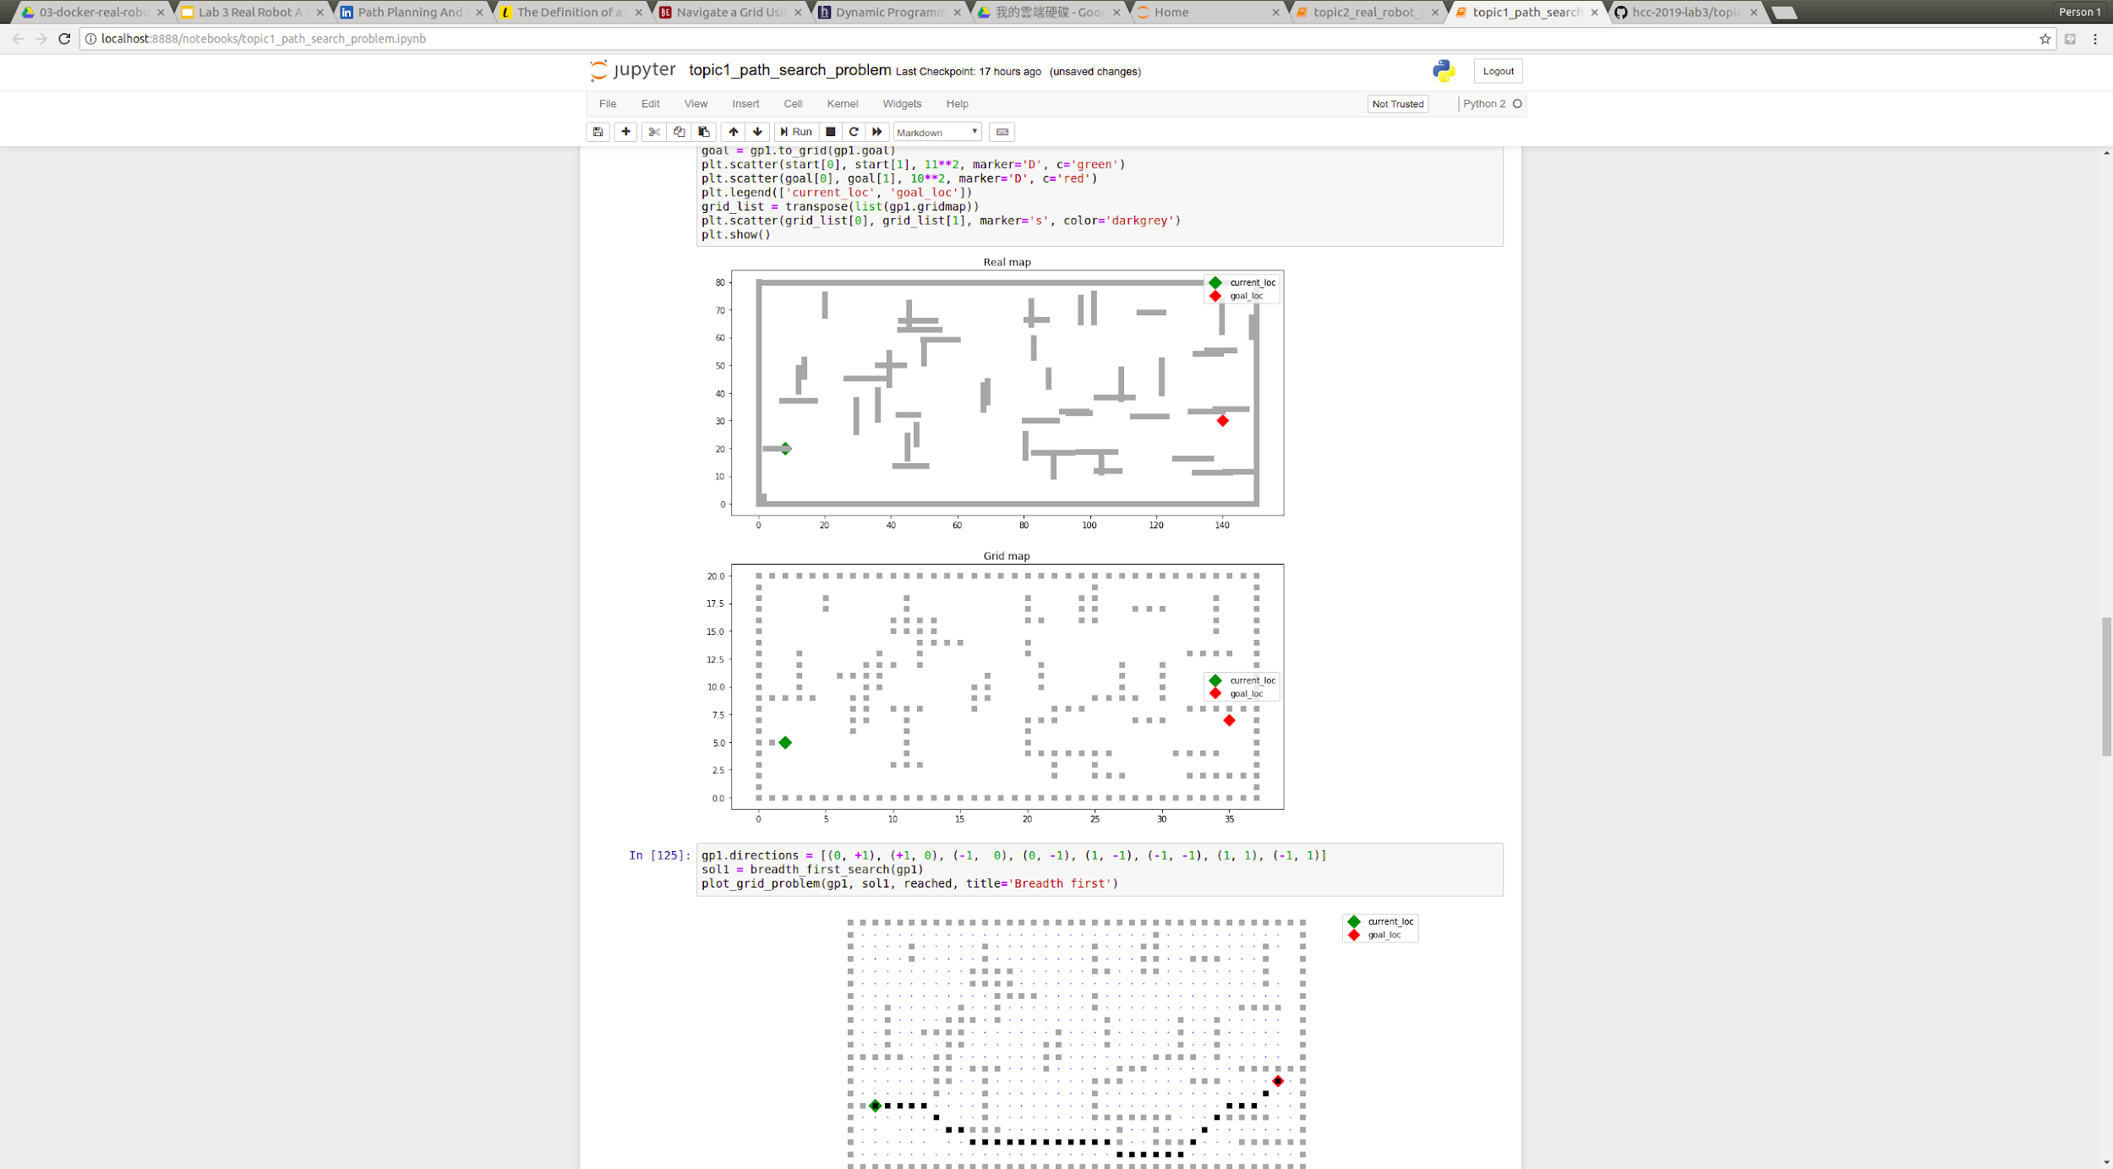
Grid Problem
Example: find a path from current point to goal point
map size = 150 unit * 80 uint
map size = 150 unit * 80 uint, grid size = 4 uint

Slide 7
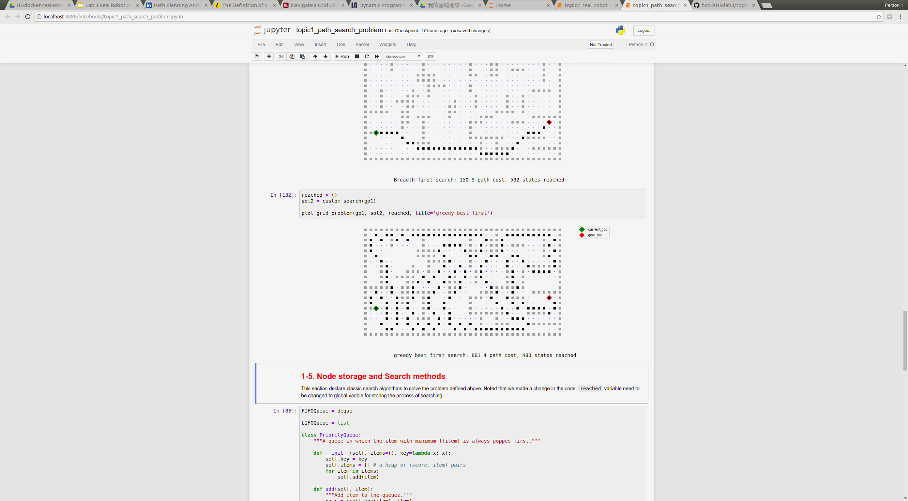
Path planning
Search a proper path for your robot
Do you thing it is a good planning algorithm?
Maybe it is good planning for finding artifact

Slide 8
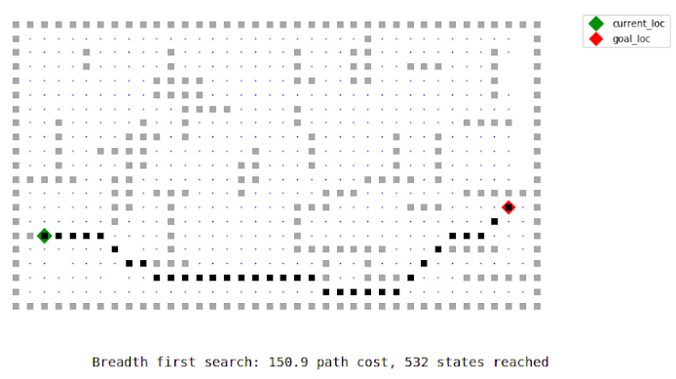
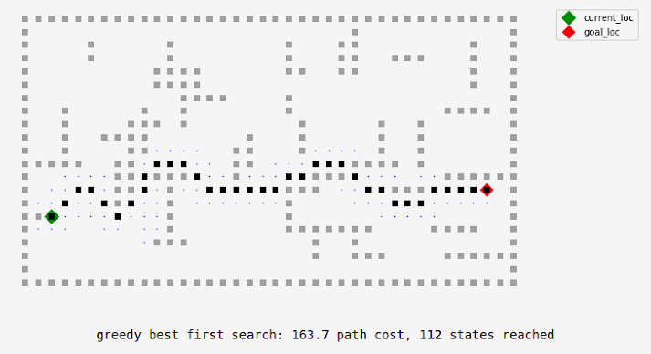
Path planning
The efficiency of search is depend on you problem formulation
You may consider the computing time or path cost or any limitation
BFS?
Greedy best first ?
Or more?
Notes:
老師上週也介紹了很多

Slide 9
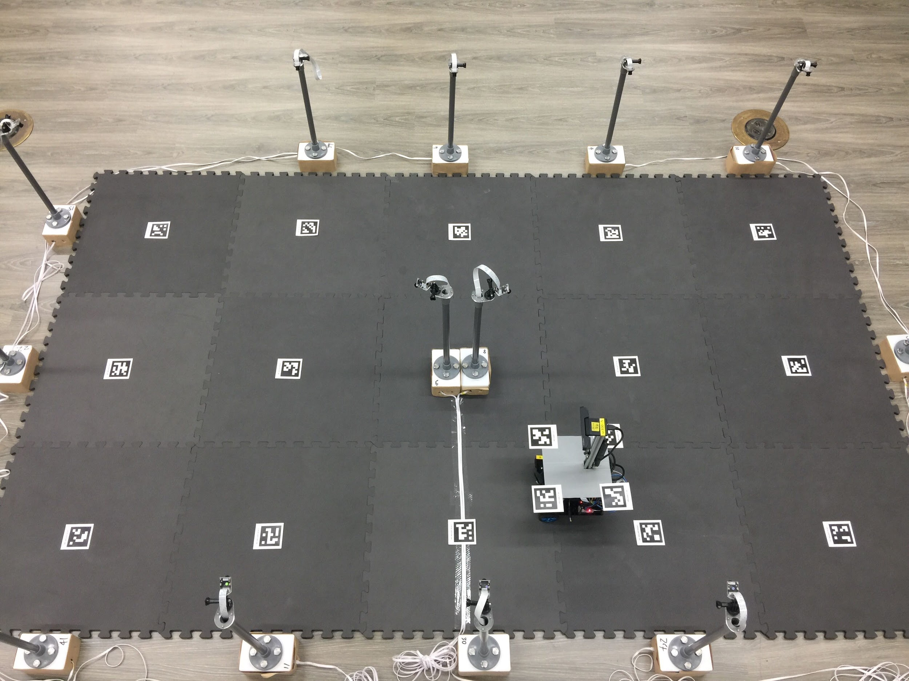
Lab tutorial
So, your main mission today is design a proper search algorithm for grid problem.
Run the code (with your custom search algorithm) on
In virtual environment (jupyter notebook)
In real world shown below

Slide 10
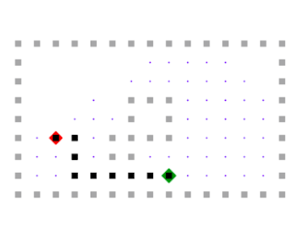
Lab tutorial
(40 mins) Topic 1: Large map in virtual environment (jupyter notebook)
verify some code to optimize the mobility of robot
design an algorithm based on Best-First-Search we talked last week.
(10 mins per team) Topic 2: Small map in real world
Copy one code cell from topic 1 to topic 2
Run jupyter notebook to publish path list to ROS control node, and you will see robot moving
Notes:
講完topic

Slide 11
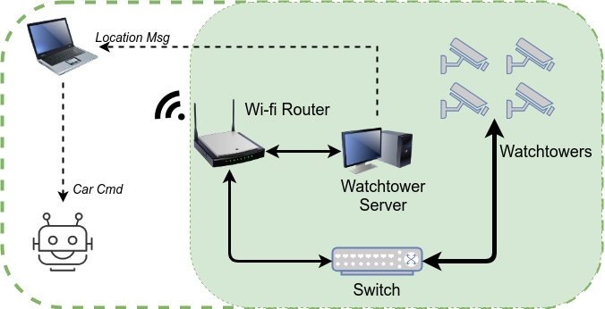
Lab tutorial
System of topic 2 is shown below
(Please ask TA for setup or any questions)

